Slide 1

INTRODUCTION TO VHDL
By
Mayuresh Piske
design@fpgasolution.com
www.fpgasolution.com

Slide 2
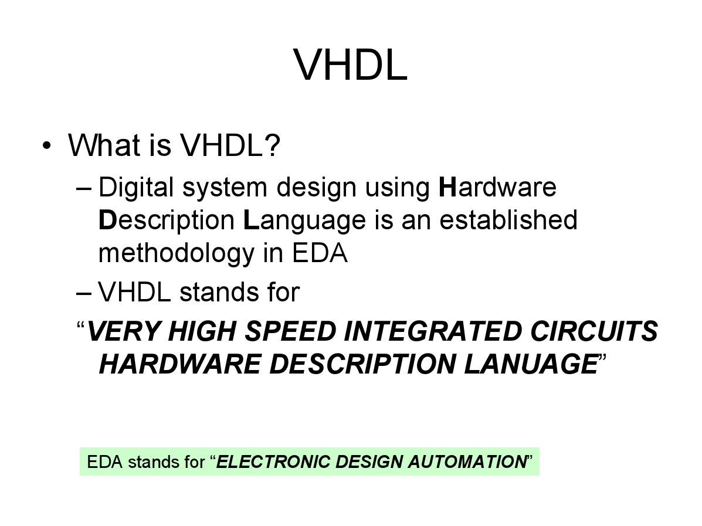

Slide 3
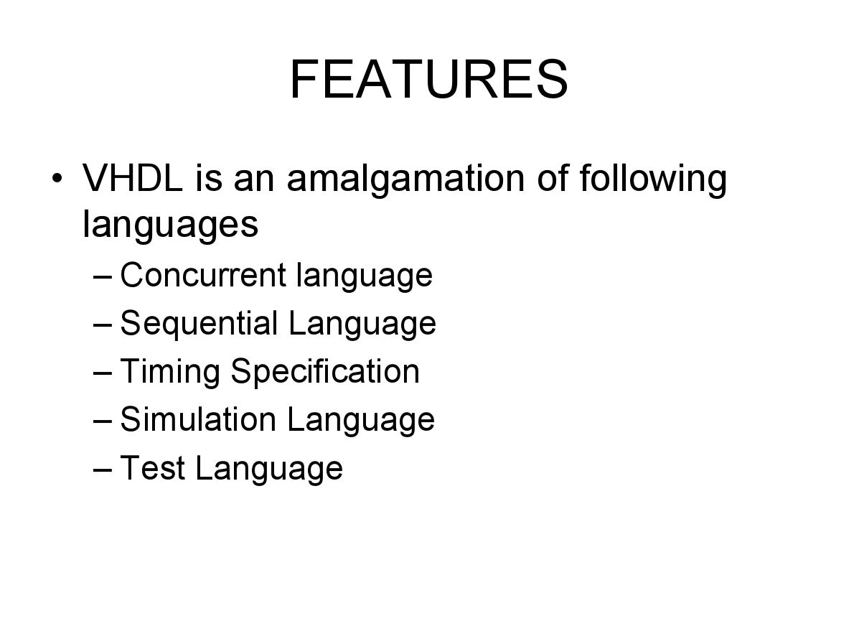

Slide 4
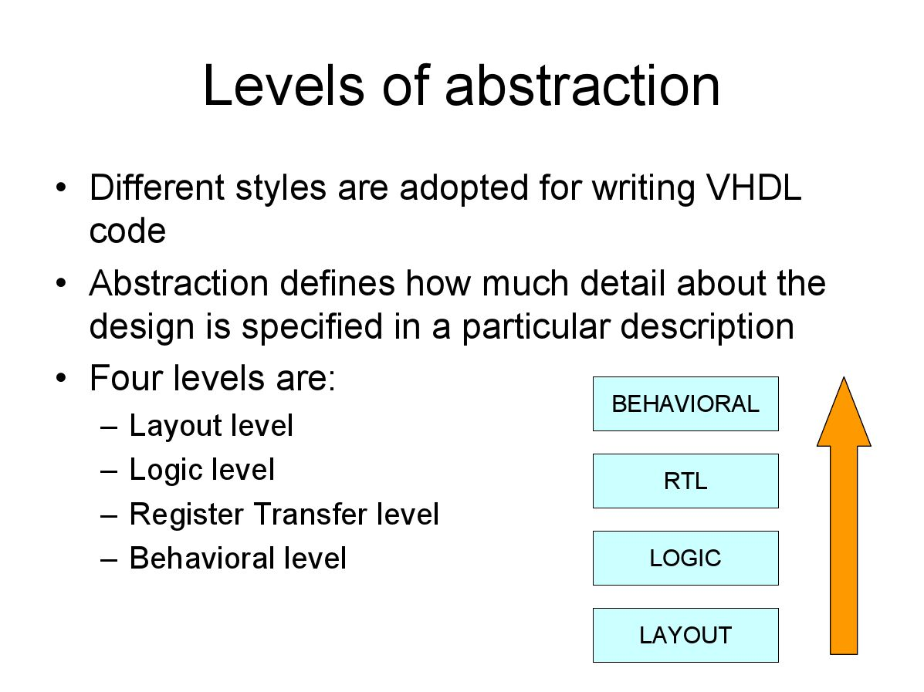

Slide 5
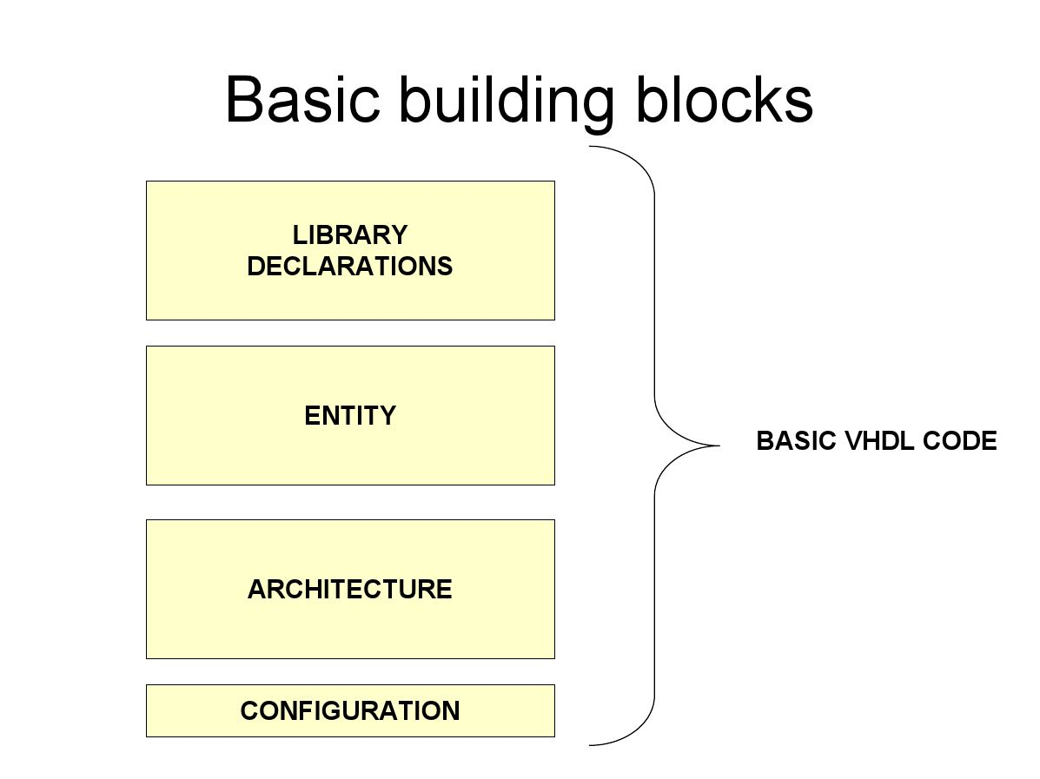

Slide 6
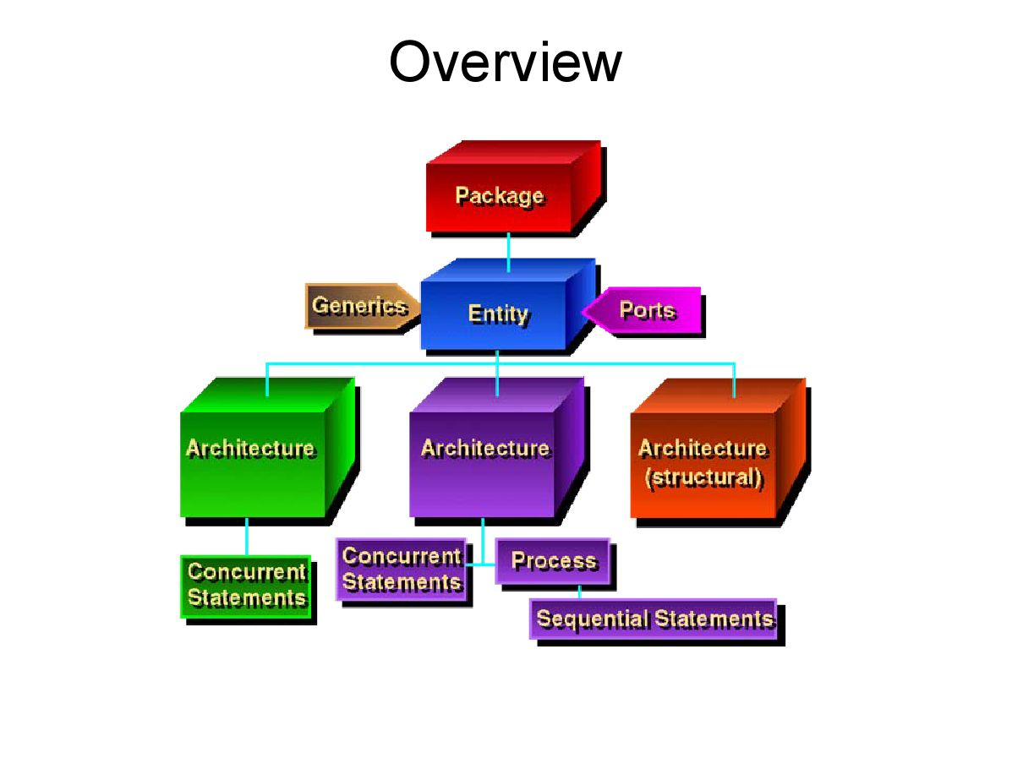

Slide 7
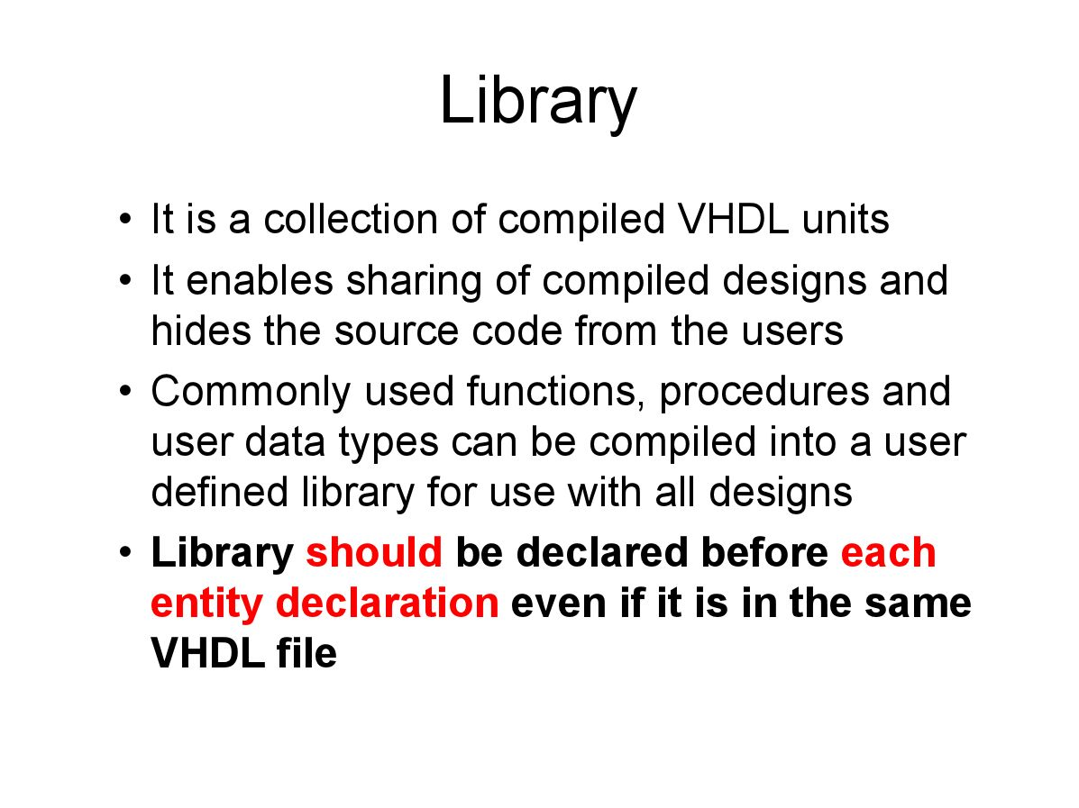

Slide 8
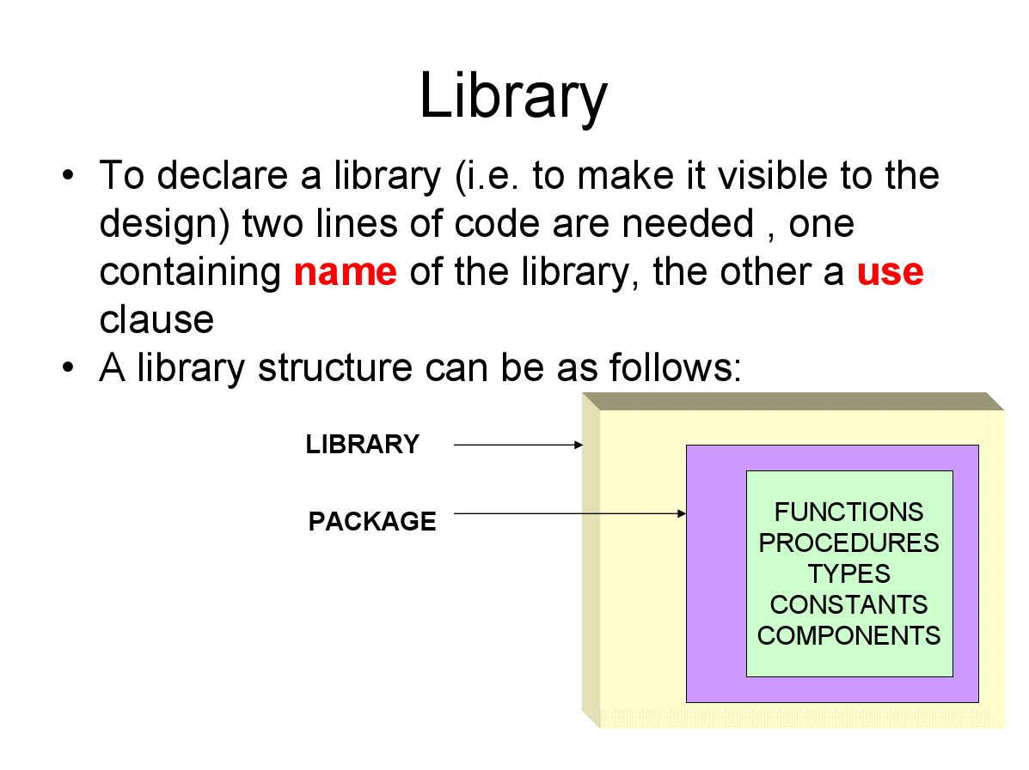

Slide 9
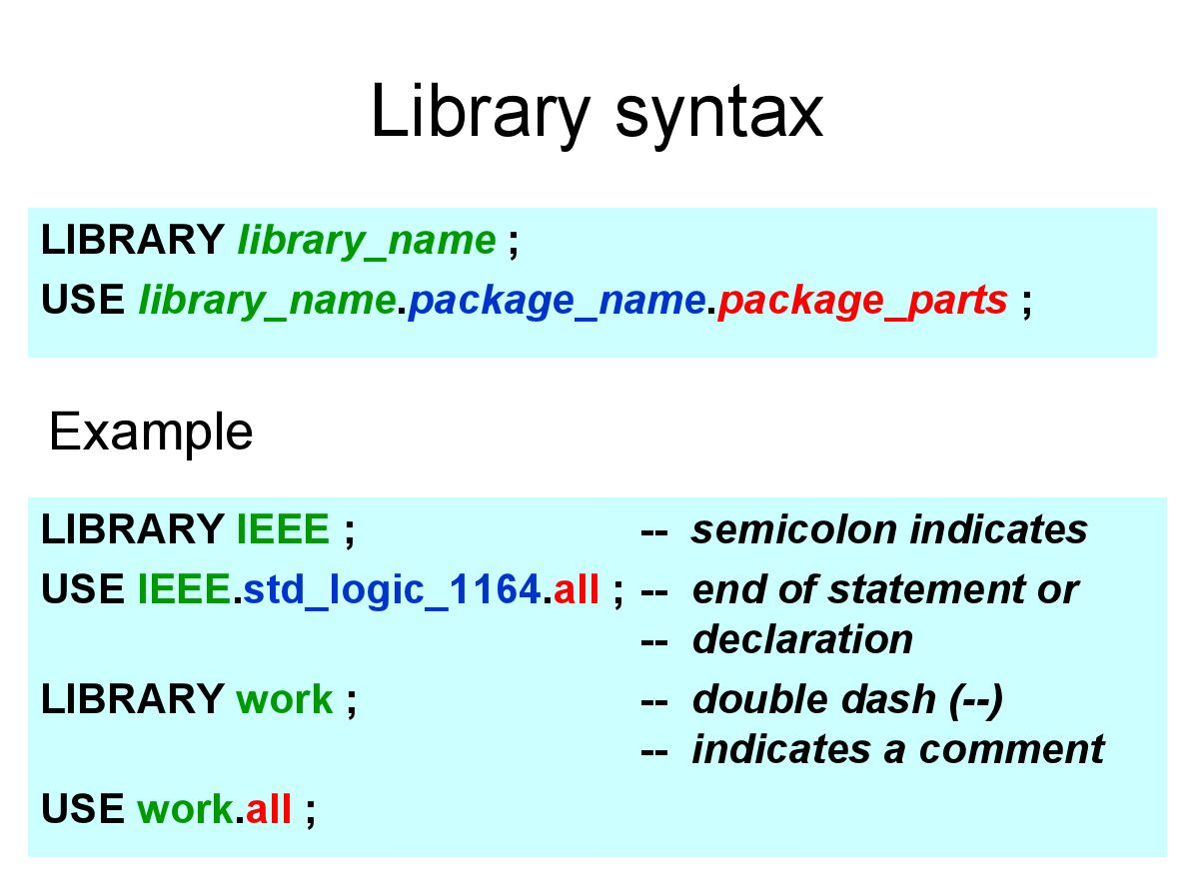

Slide 10
Multi-Valued Logic
A 9-value package STD_LOGIC_1164 was developed and accepted as IEEE Std 1164-1993.
    ‘U’ : Uninitialized
    ‘X’ : Unknown
    ‘0’ : Logic 0
    ‘1’ : Logic 1
    ‘Z’ : High impedance
    ‘W’ : weak unknown
    ‘L’ : weak logic 0
    ‘H’ : weak logic 1
    ‘-’ : Don’t care

Slide 11
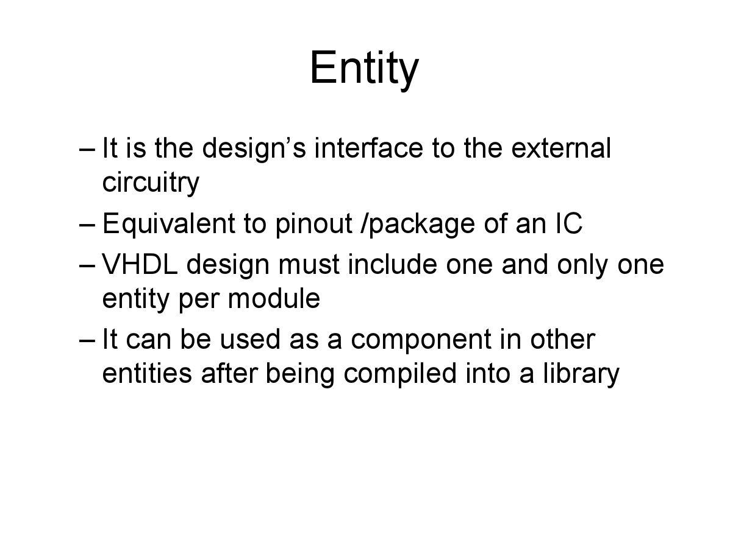

Slide 12
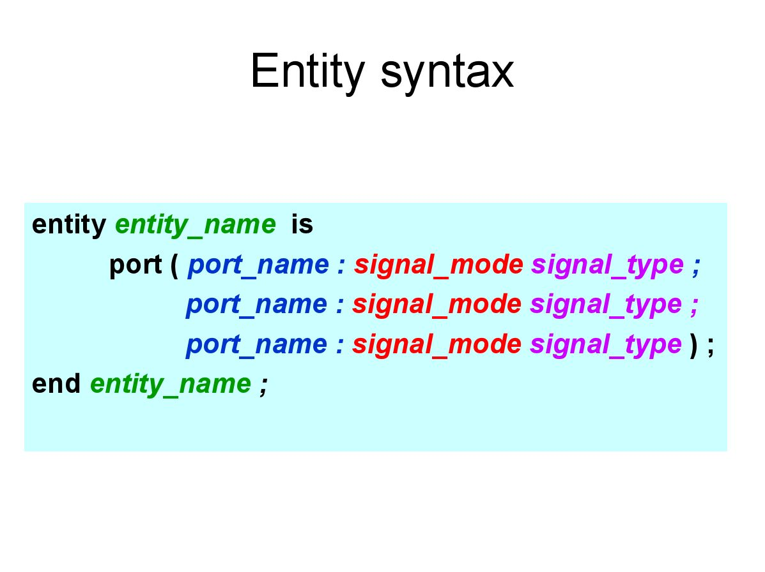

Slide 13
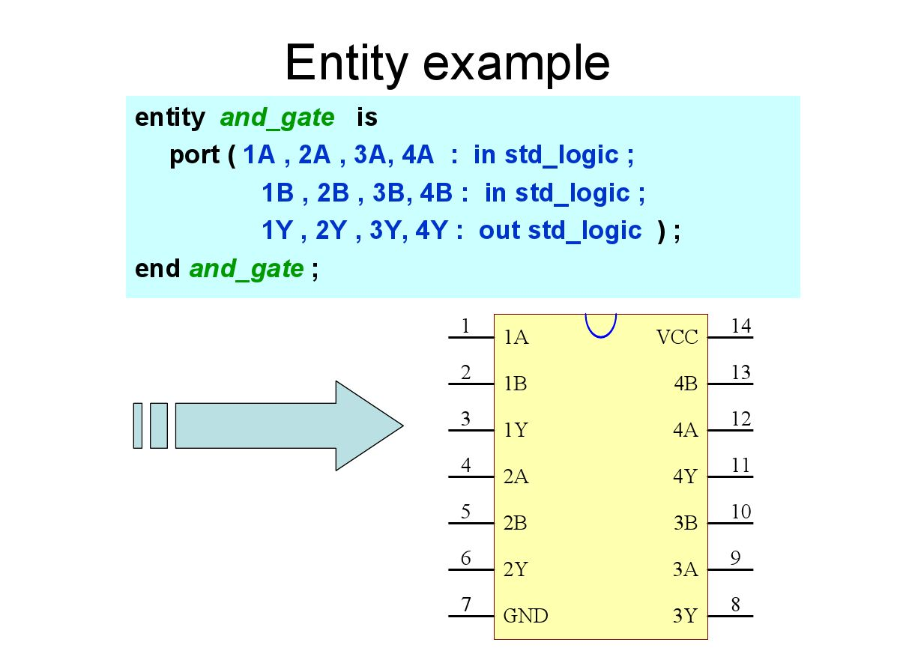

Slide 14
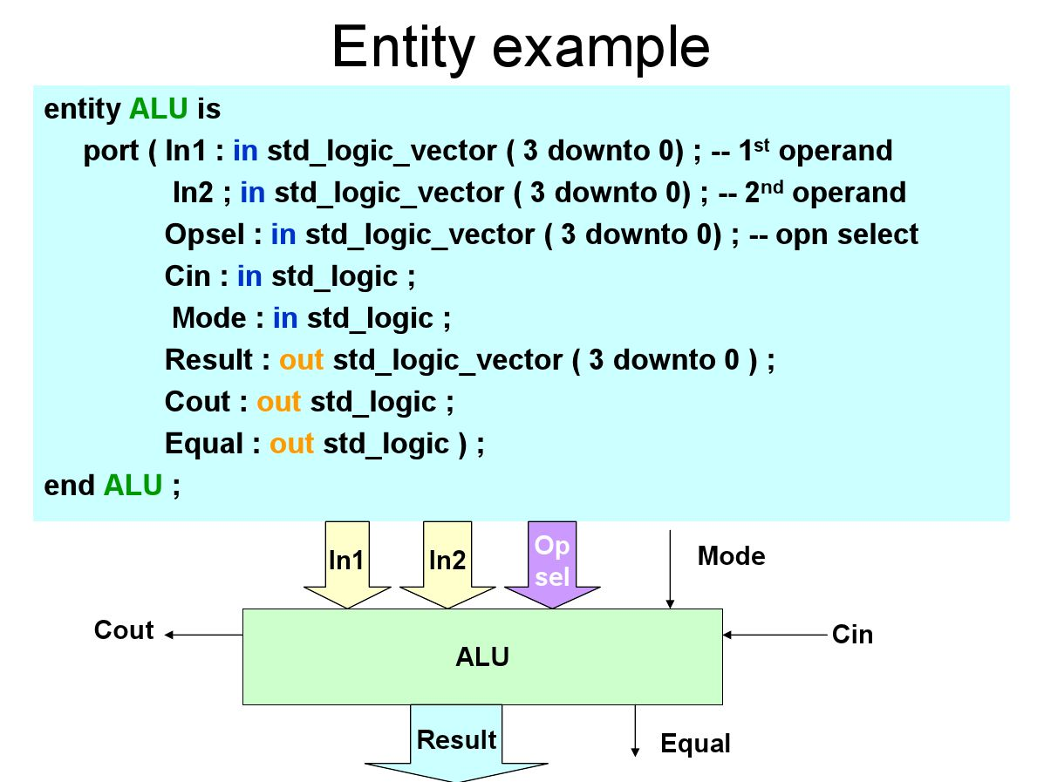

Slide 15
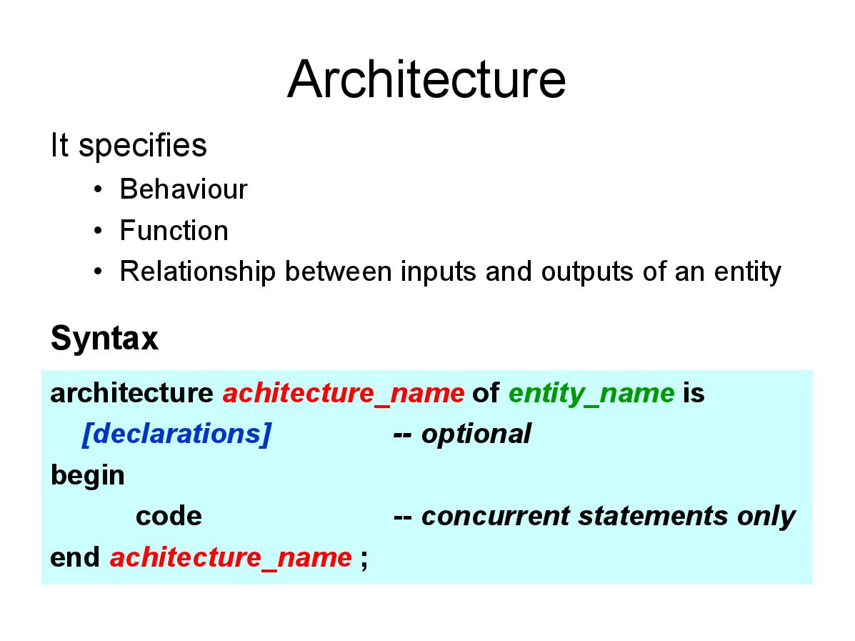

Slide 16
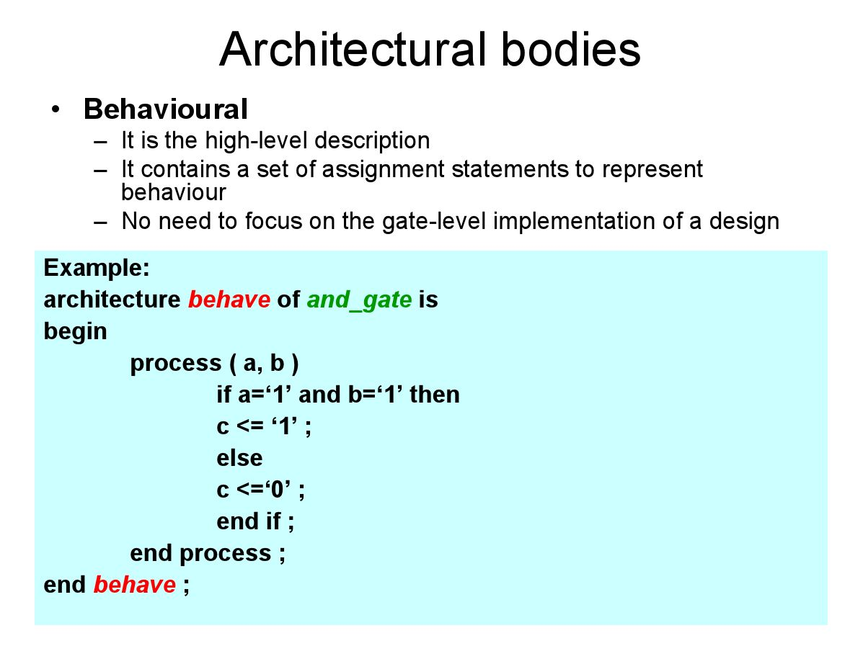

Slide 17
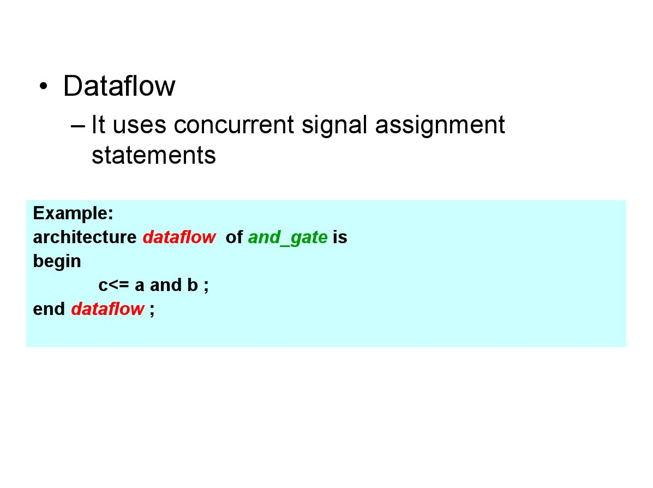

Slide 18
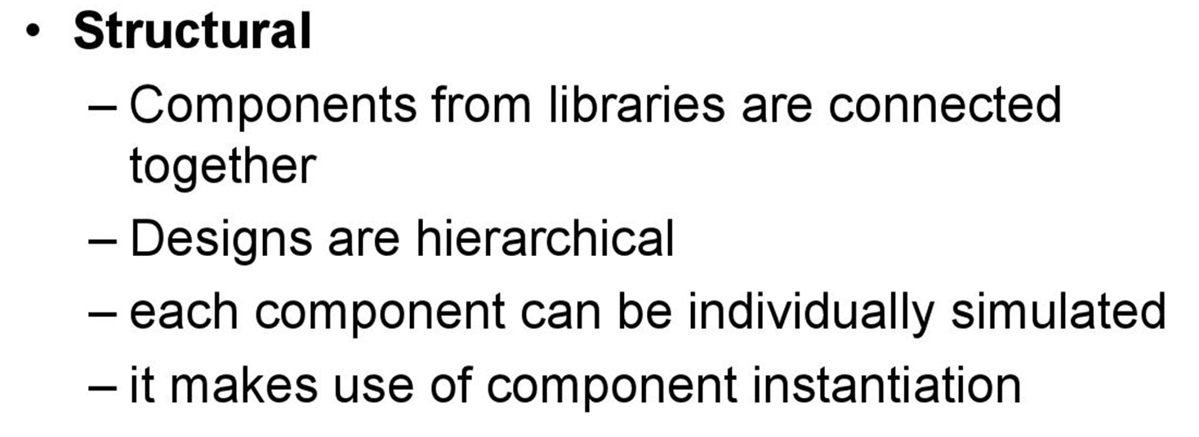

Slide 19
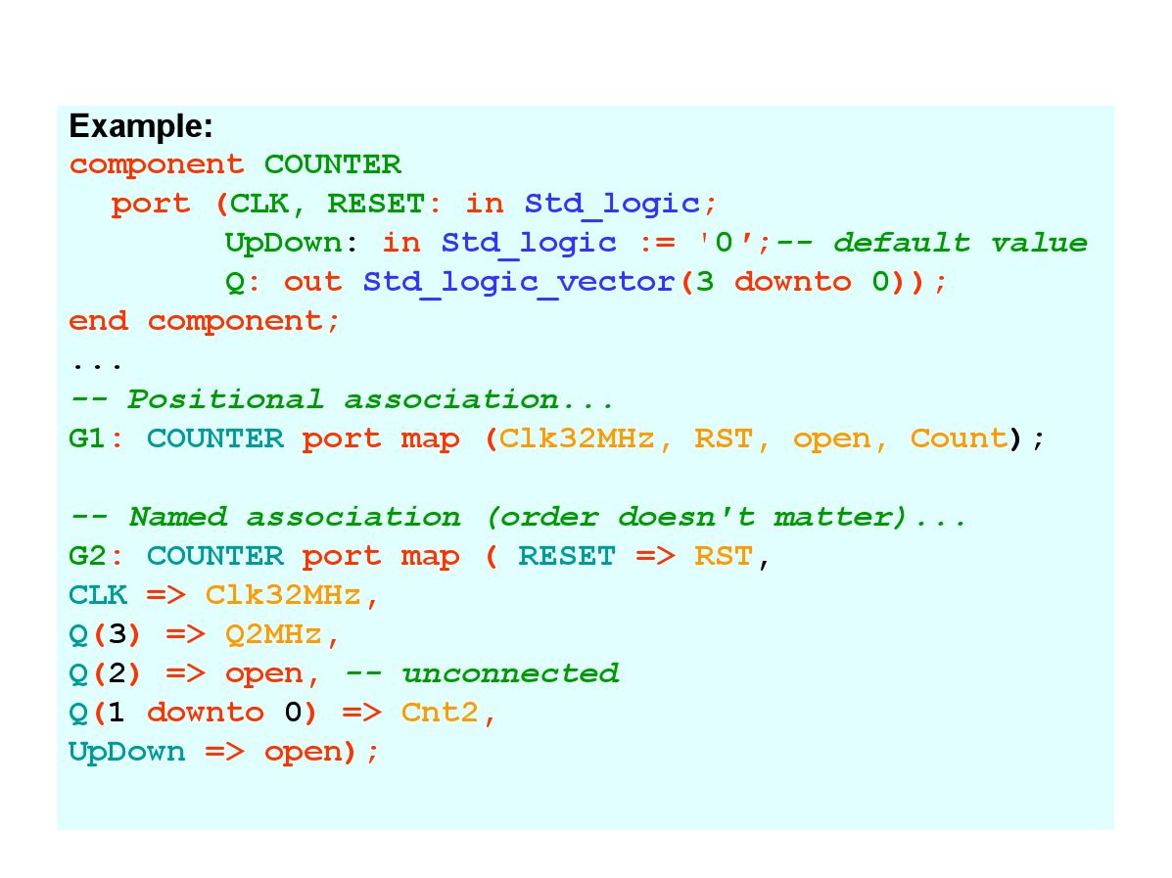

Slide 20
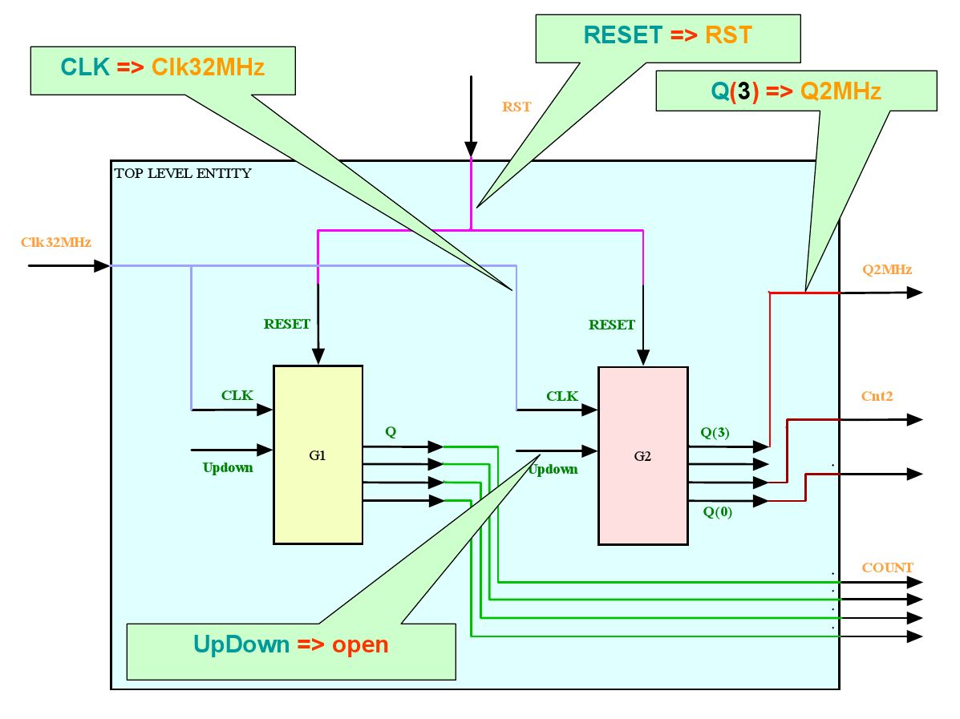

Slide 21
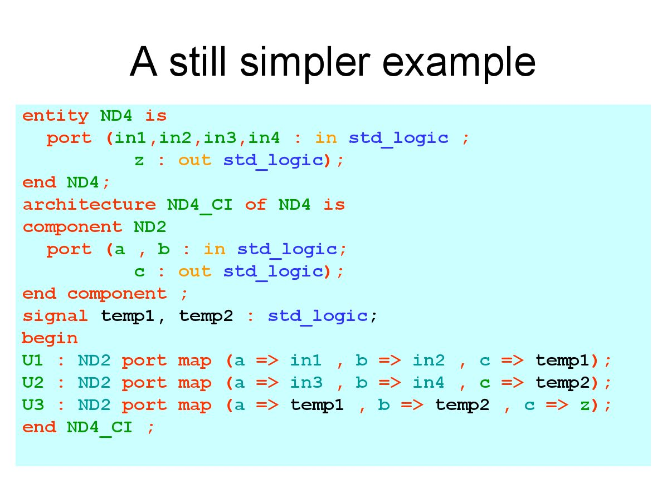

Slide 22
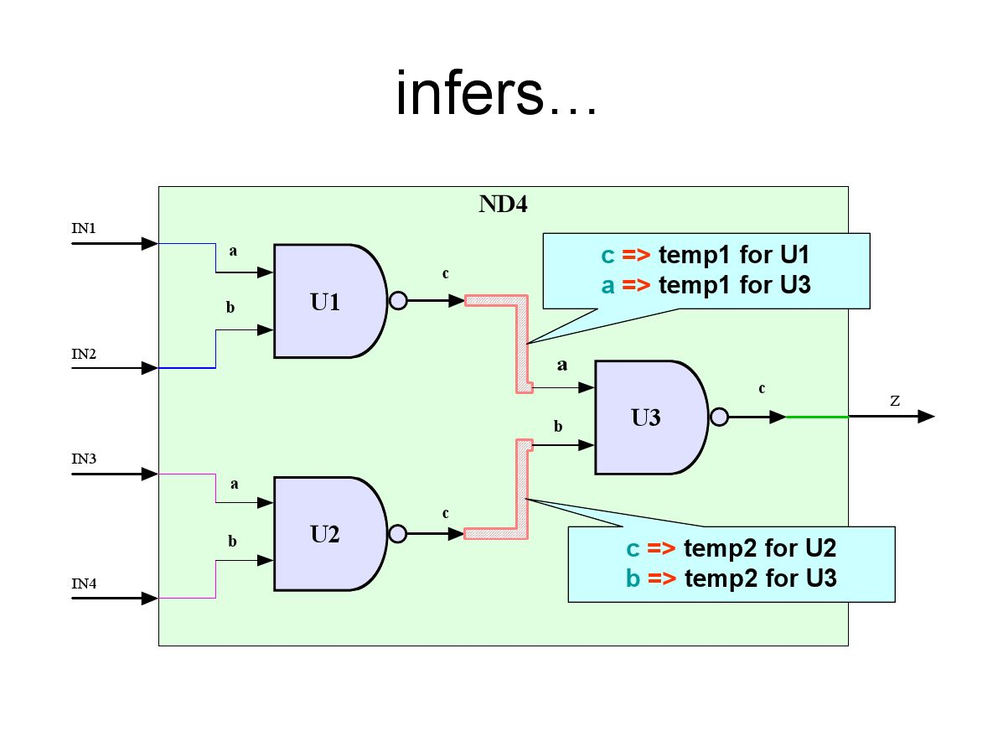

Slide 23
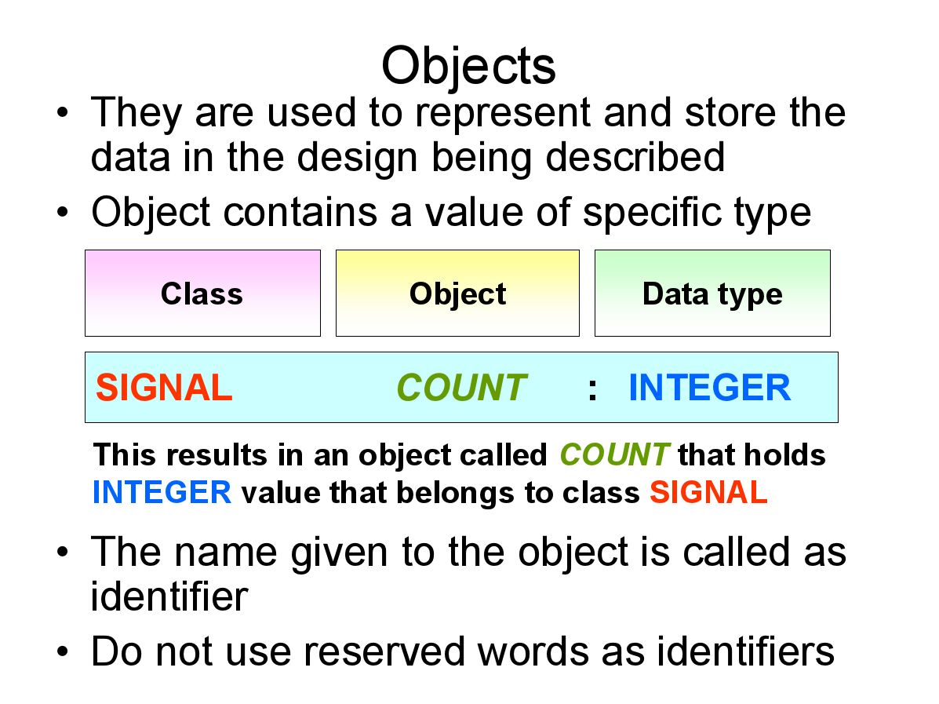

Slide 24
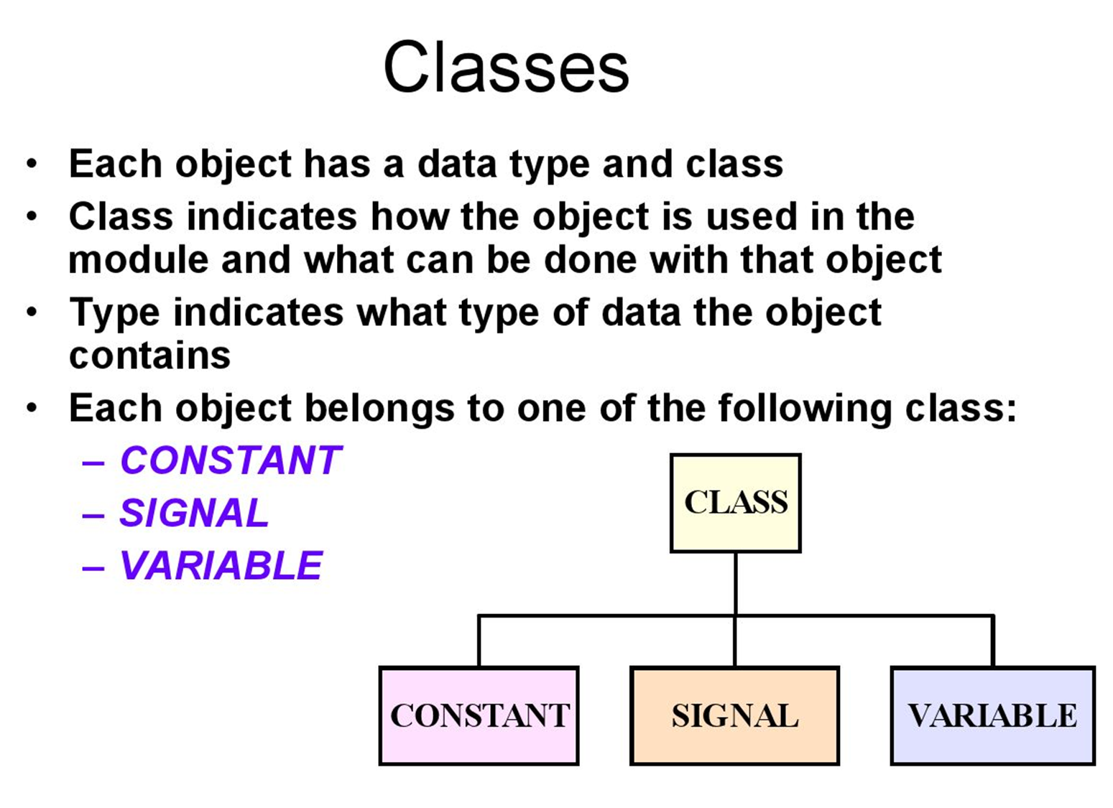

Slide 25
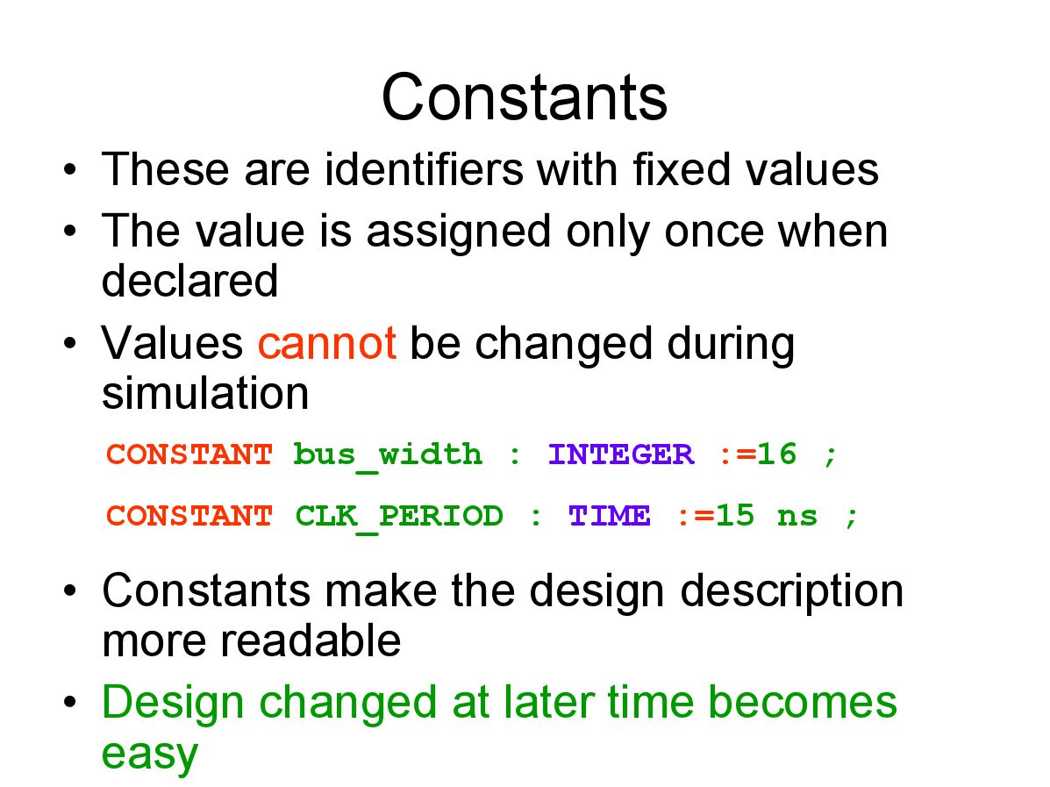

Slide 26
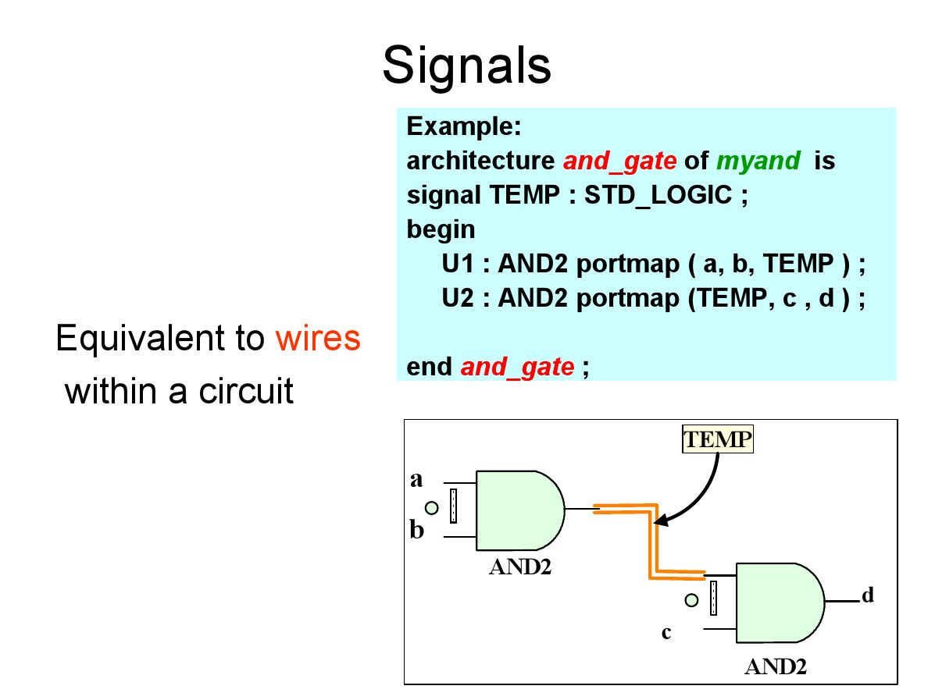

Slide 27
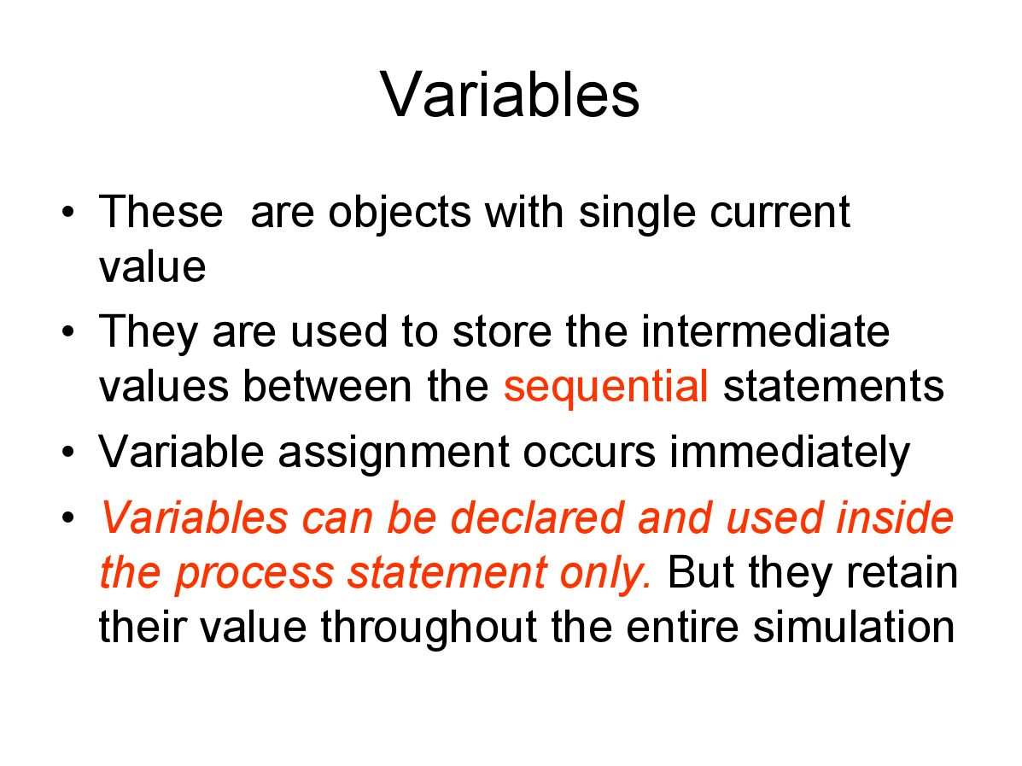

Slide 28
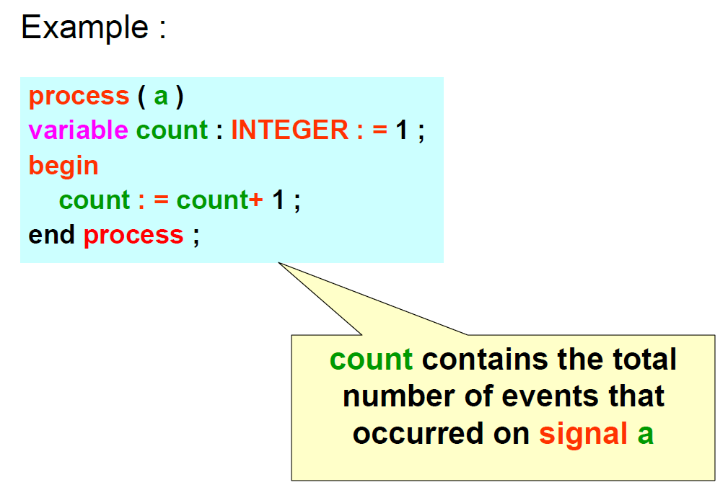

Slide 29
Data Types
In order to write VHDL code efficiently it is necessary to study the specification and use of data types
Following are the categories of data types:
Pre-defined
Used defined
Subtypes
Arrays

Slide 30
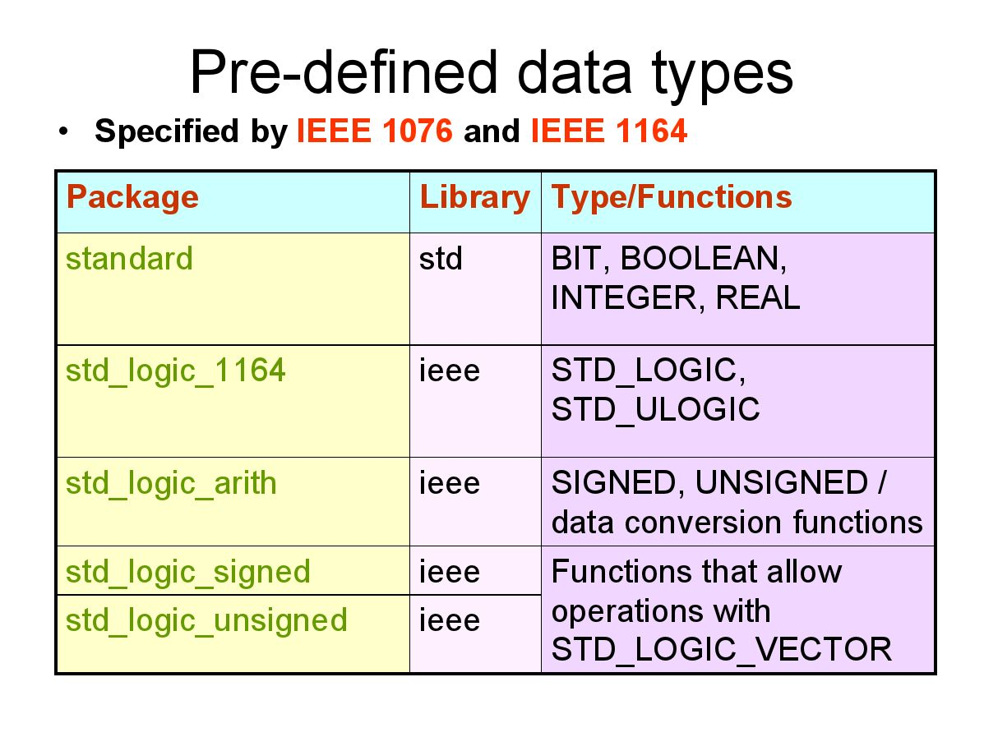

Slide 31
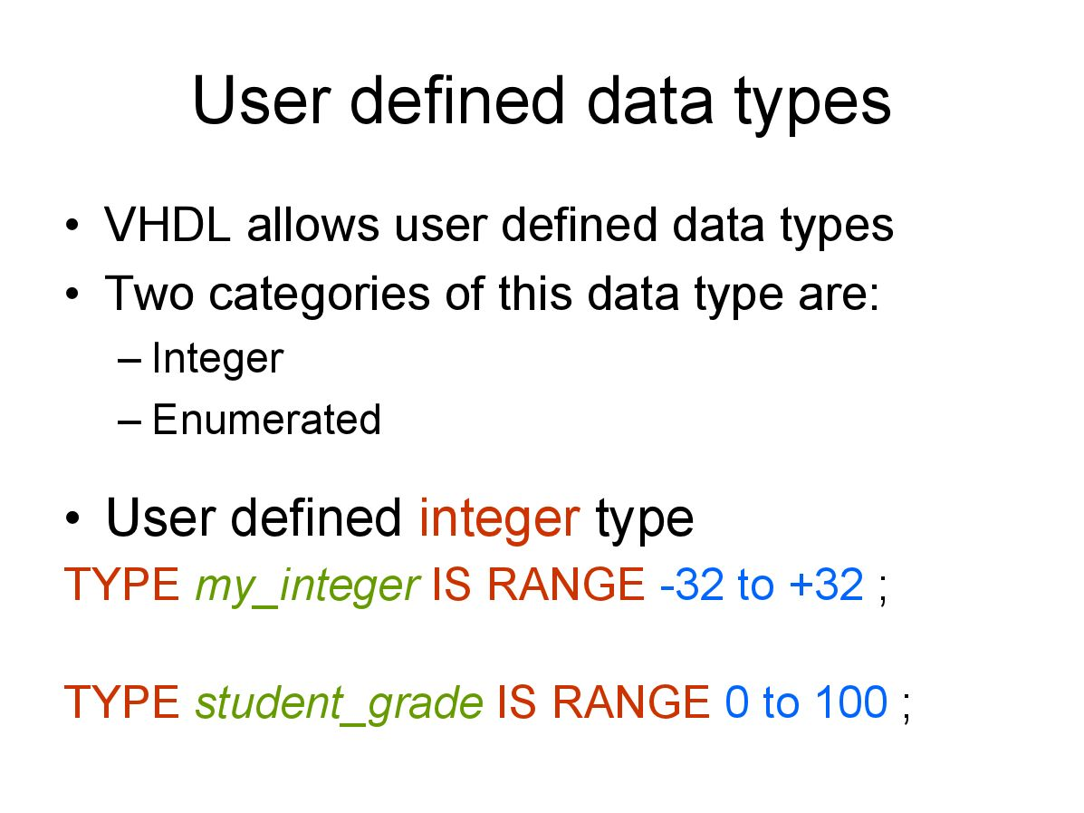

Slide 32
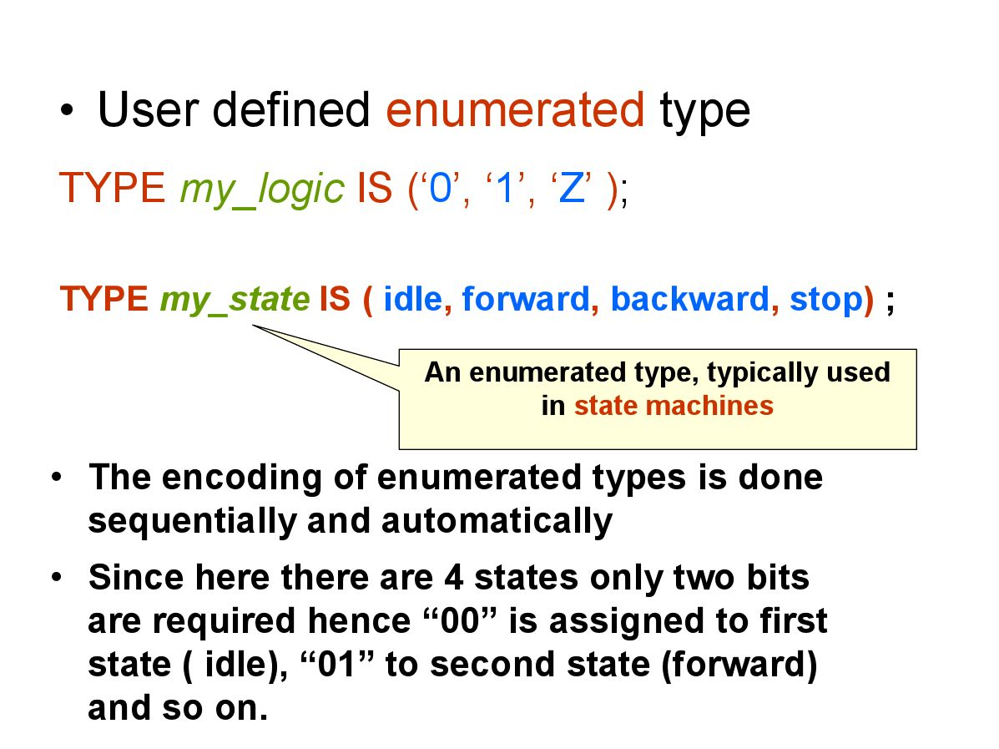

Slide 33
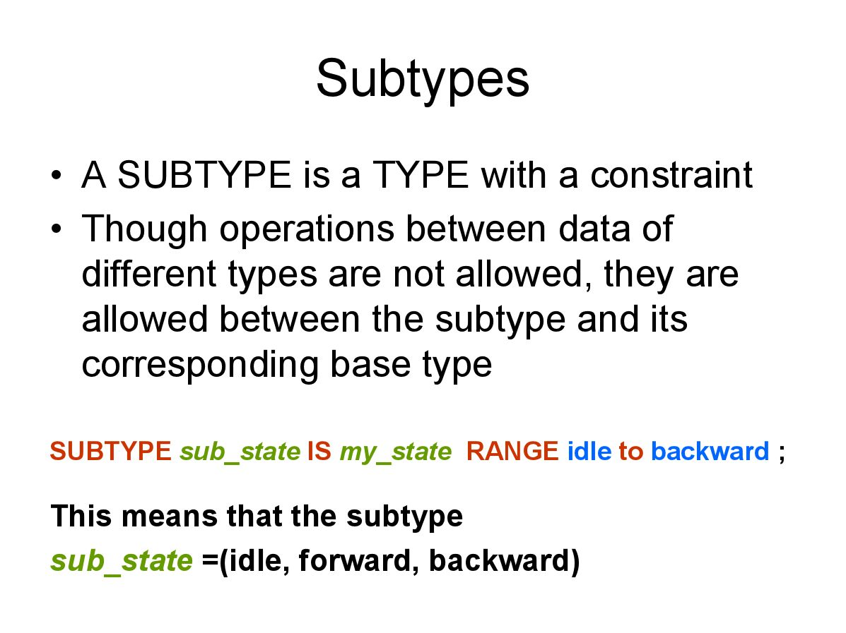

Slide 34
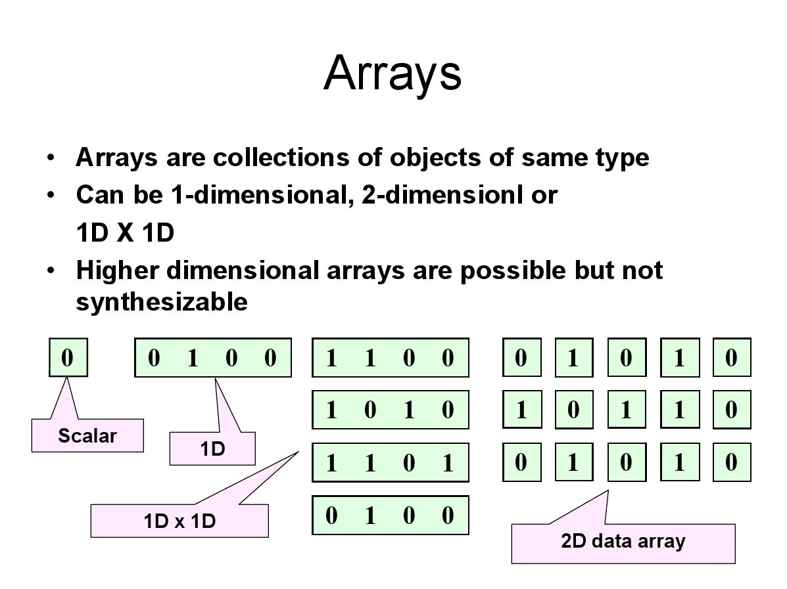

Slide 35
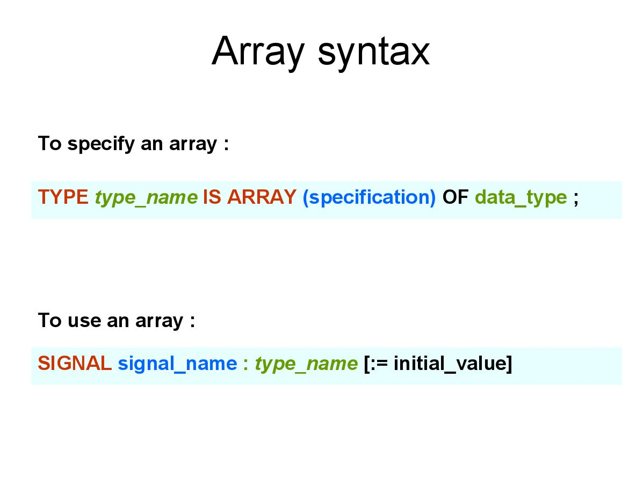

Slide 36
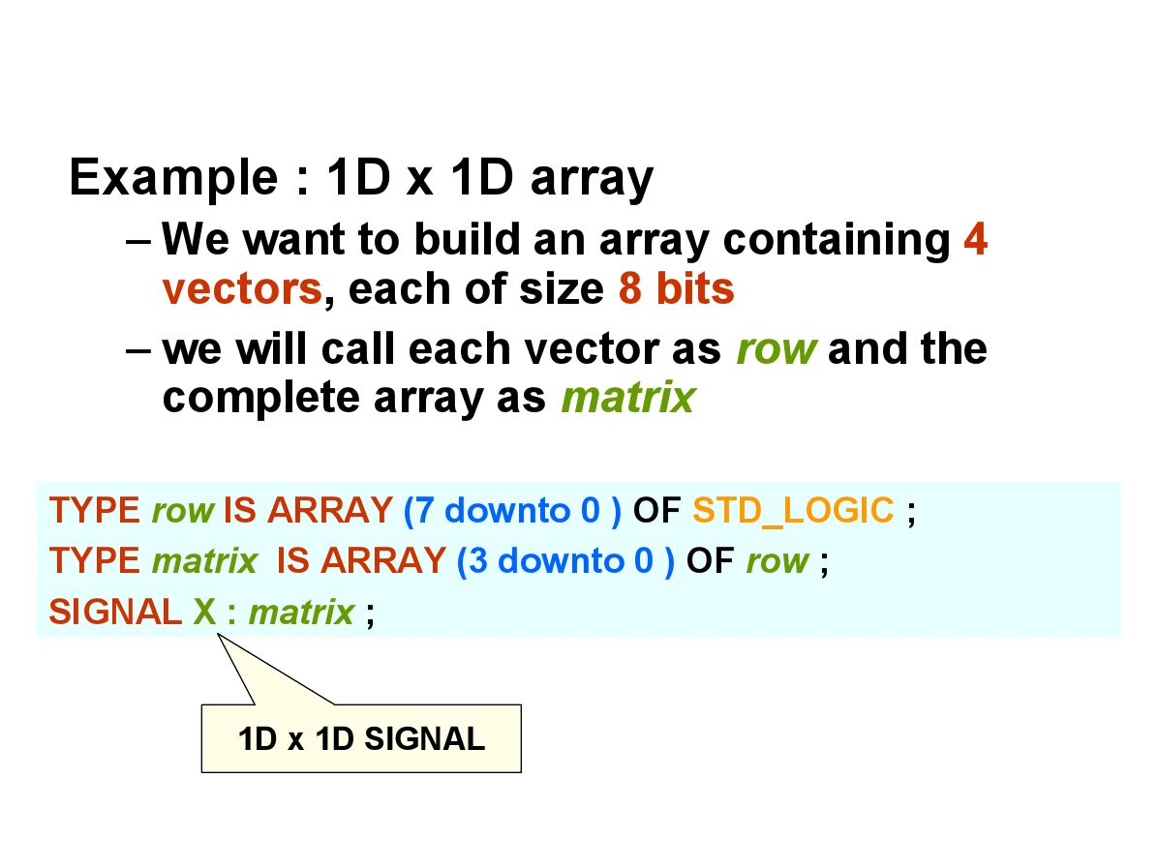

Slide 37
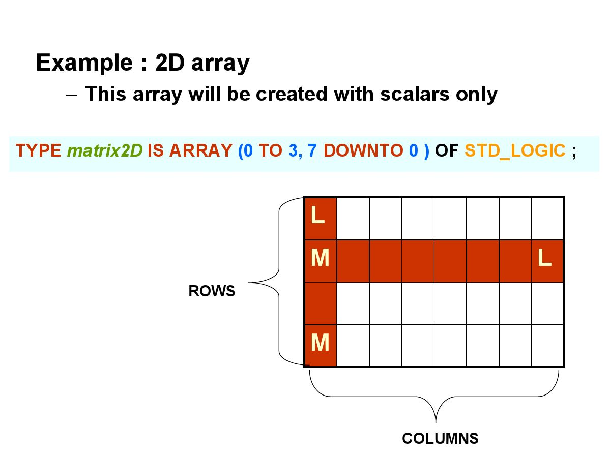

Slide 38
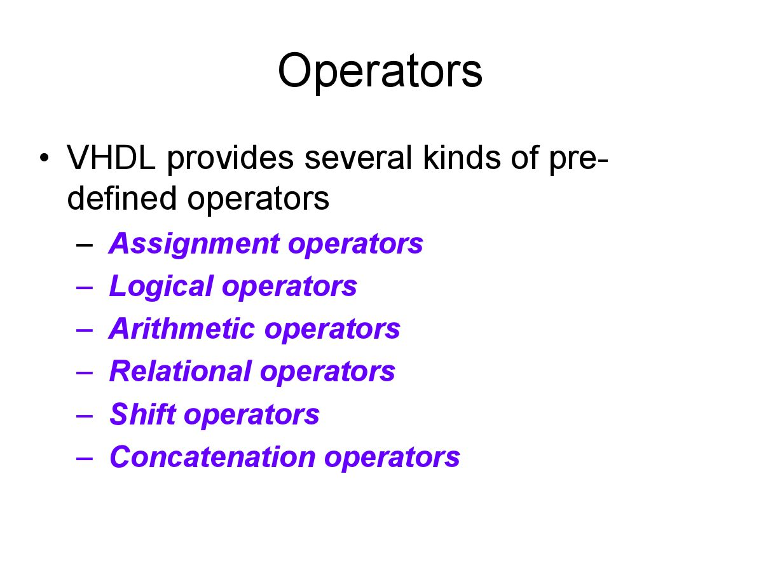

Slide 39
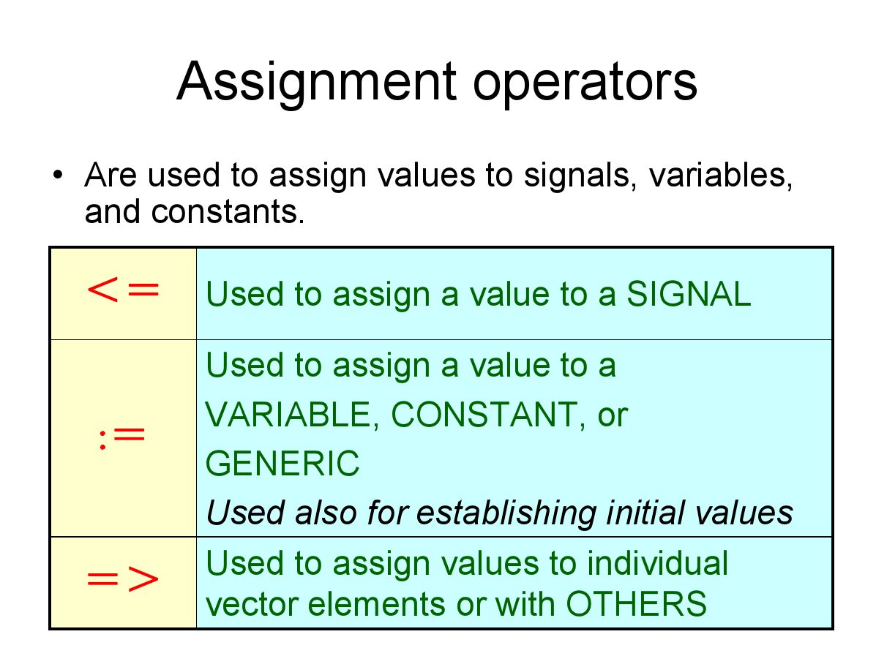

Slide 40
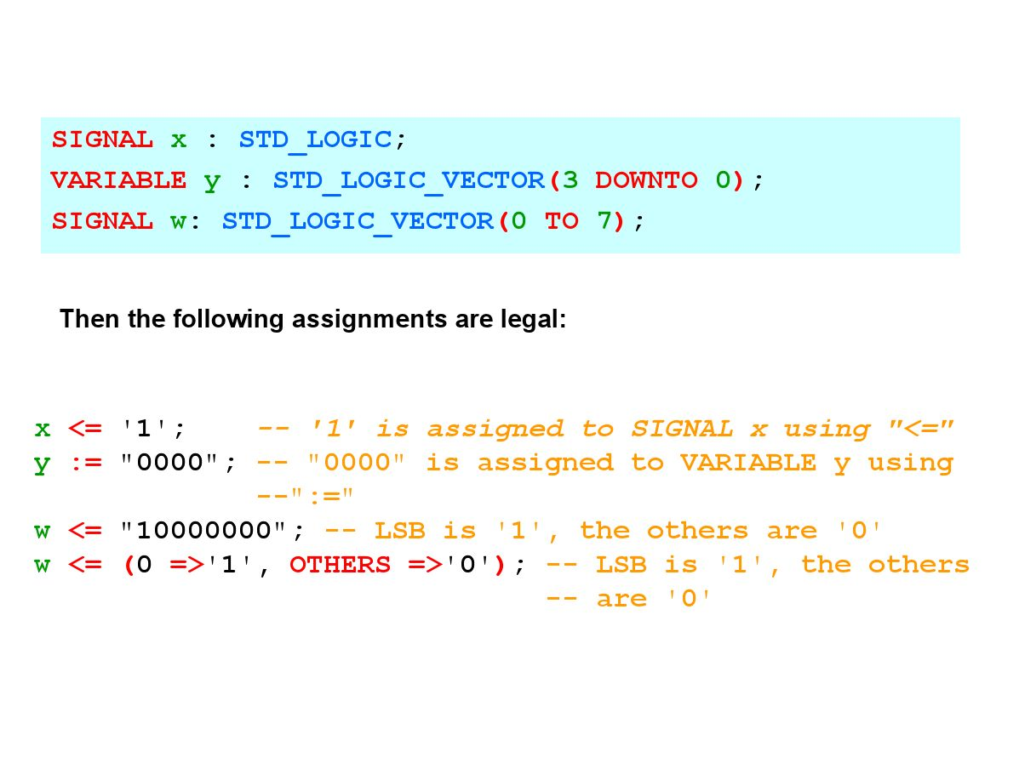

Slide 41
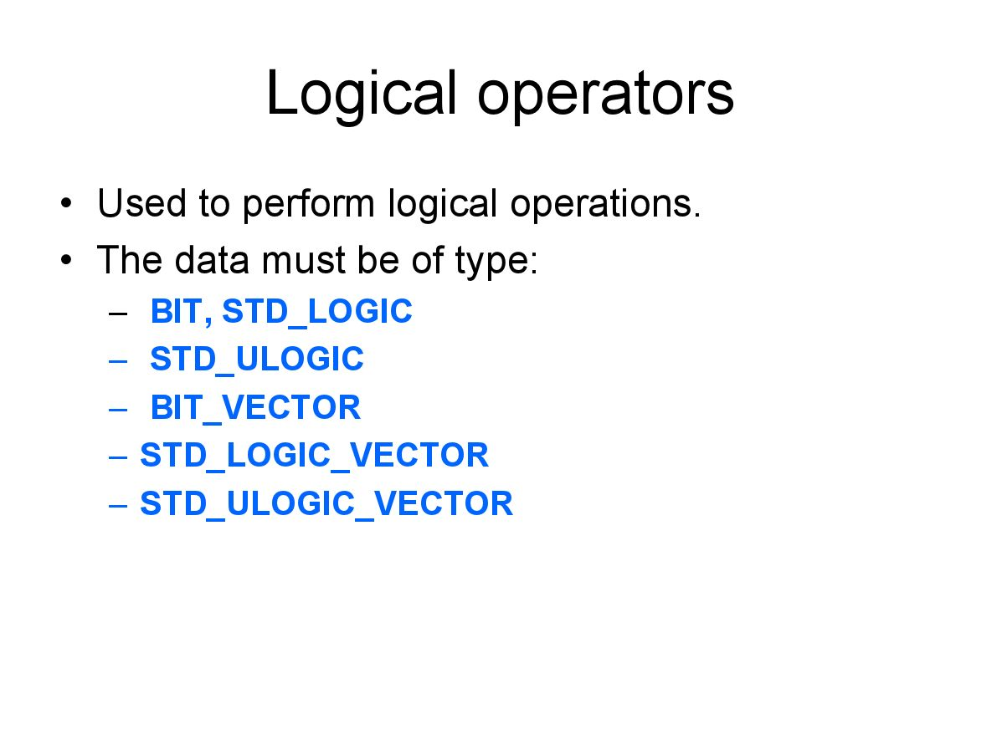

Slide 42
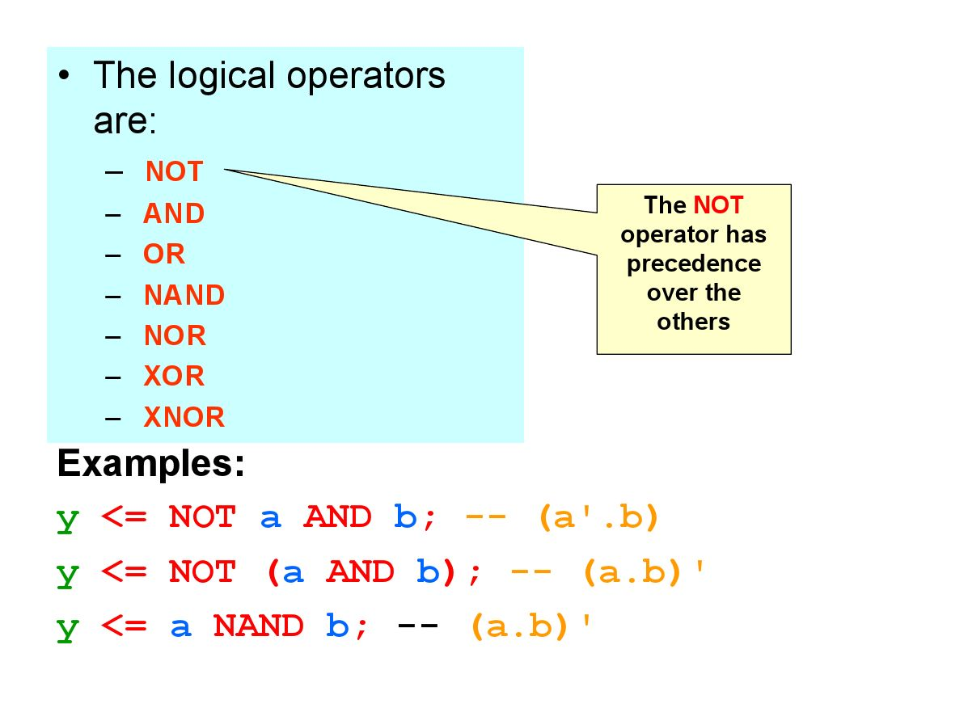

Slide 43
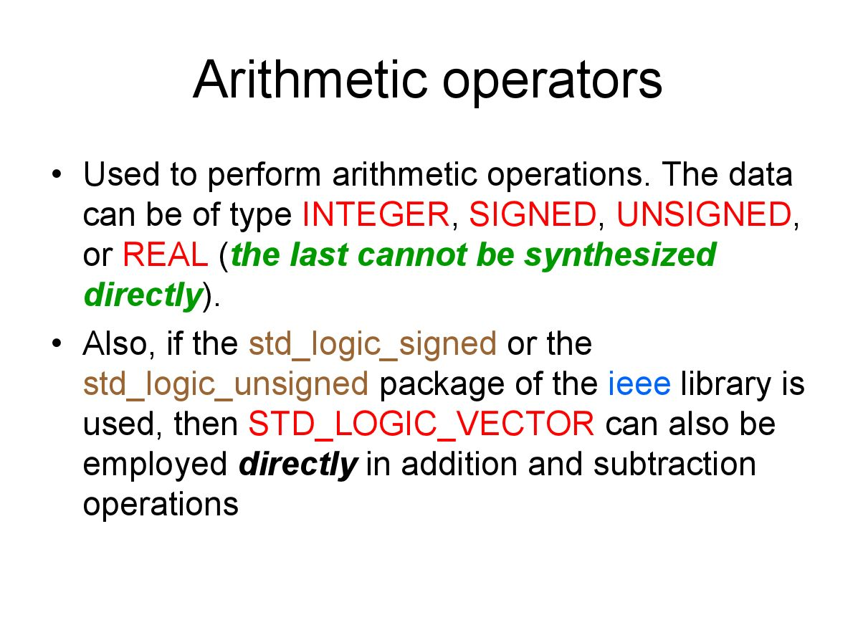

Slide 44
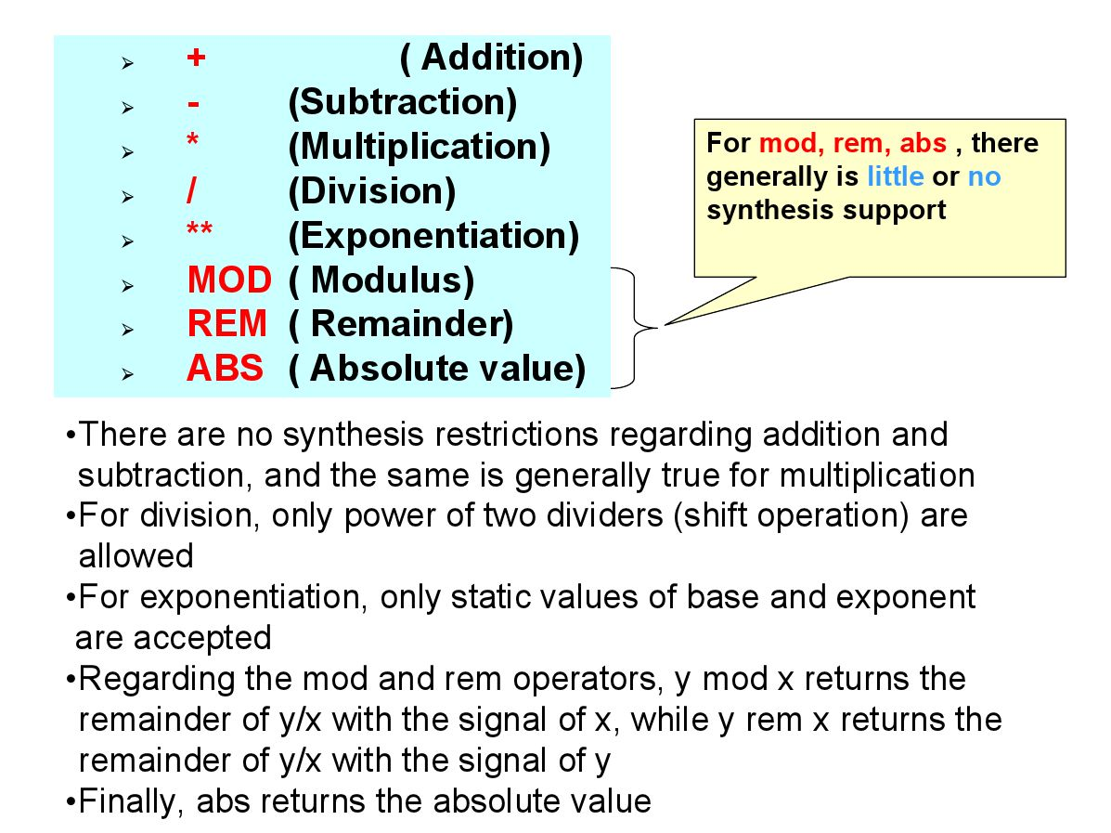

Slide 45
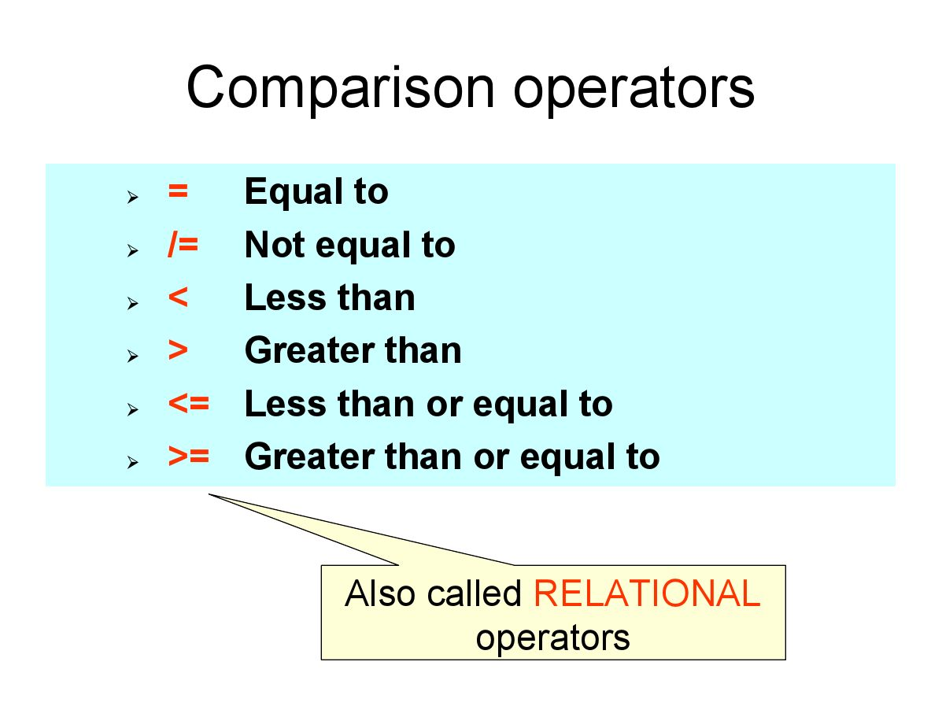

Slide 46
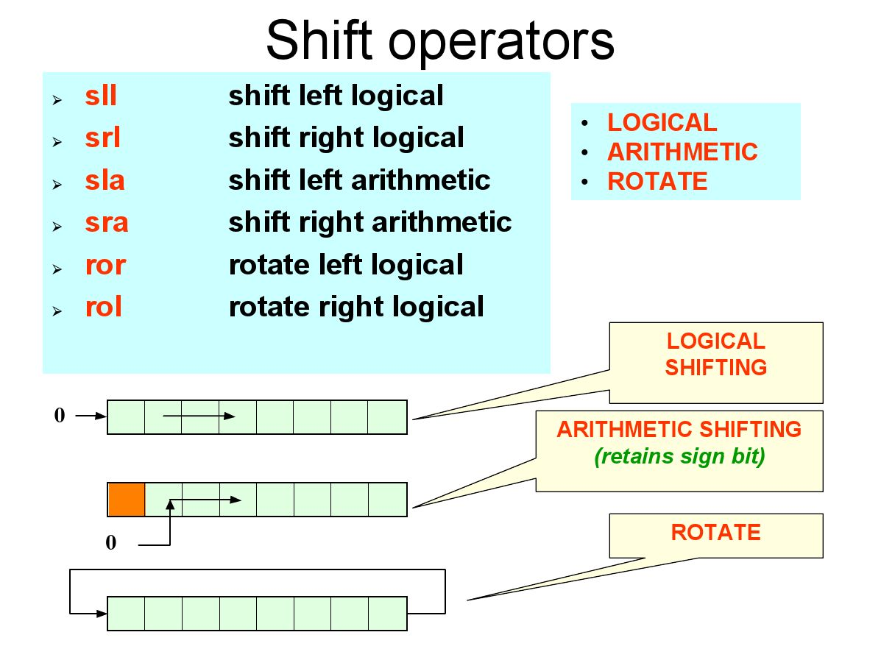

Slide 47
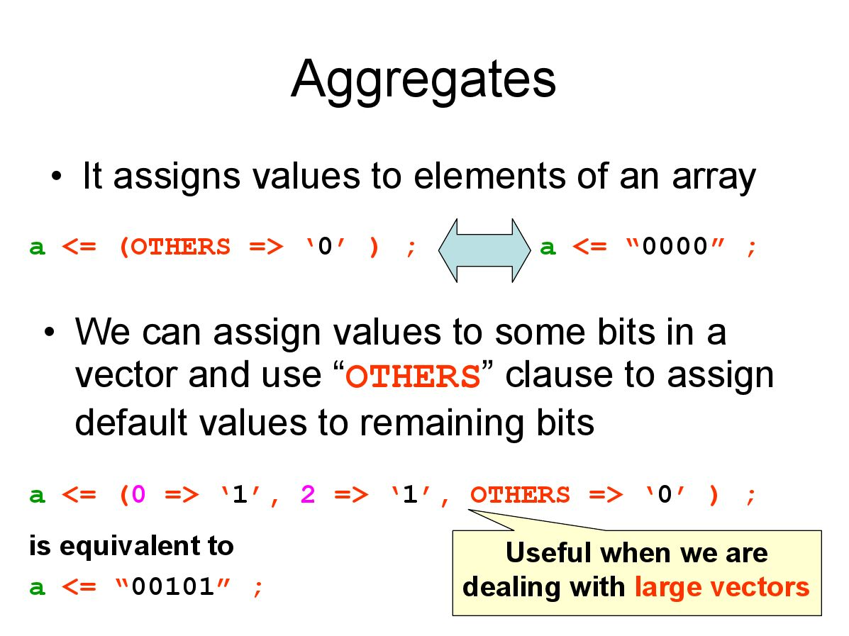

Slide 48
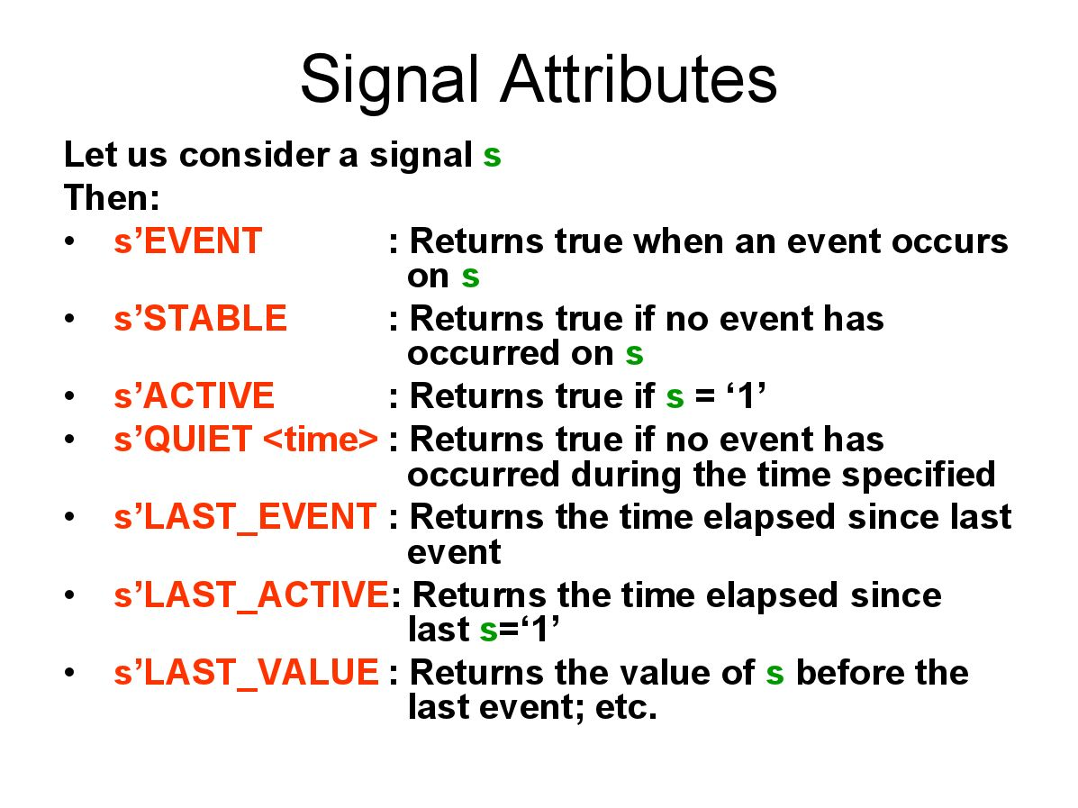

Slide 49
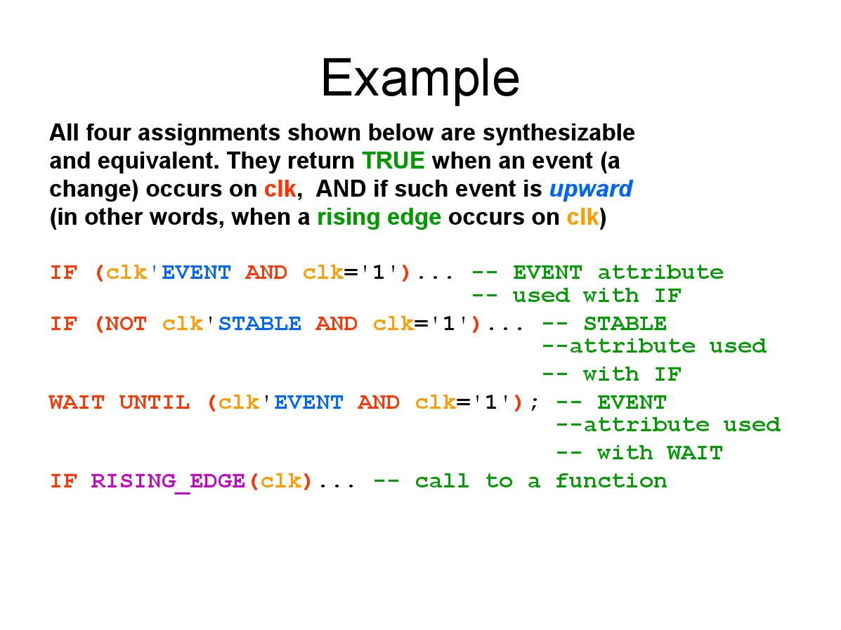

Slide 50
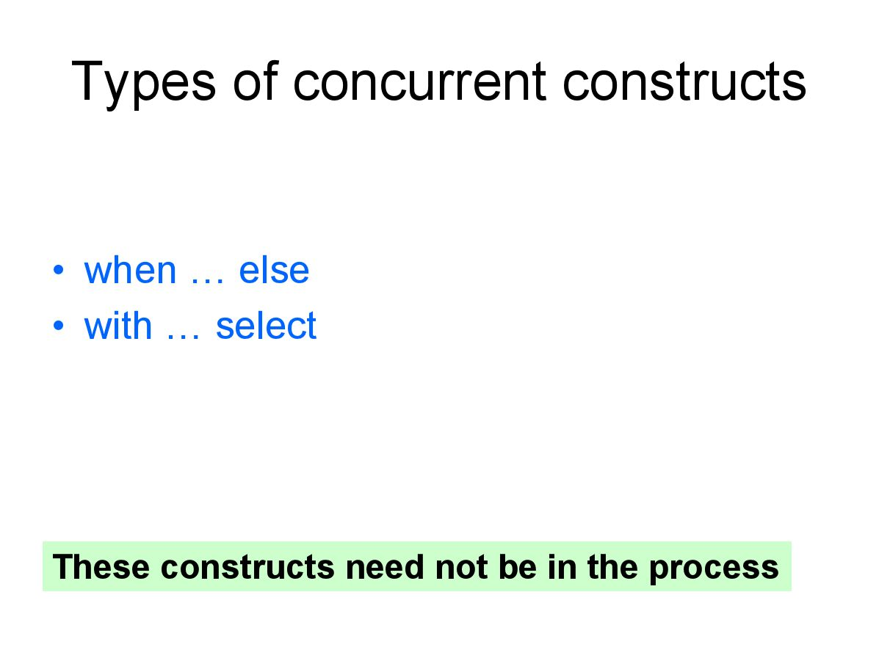

Slide 51
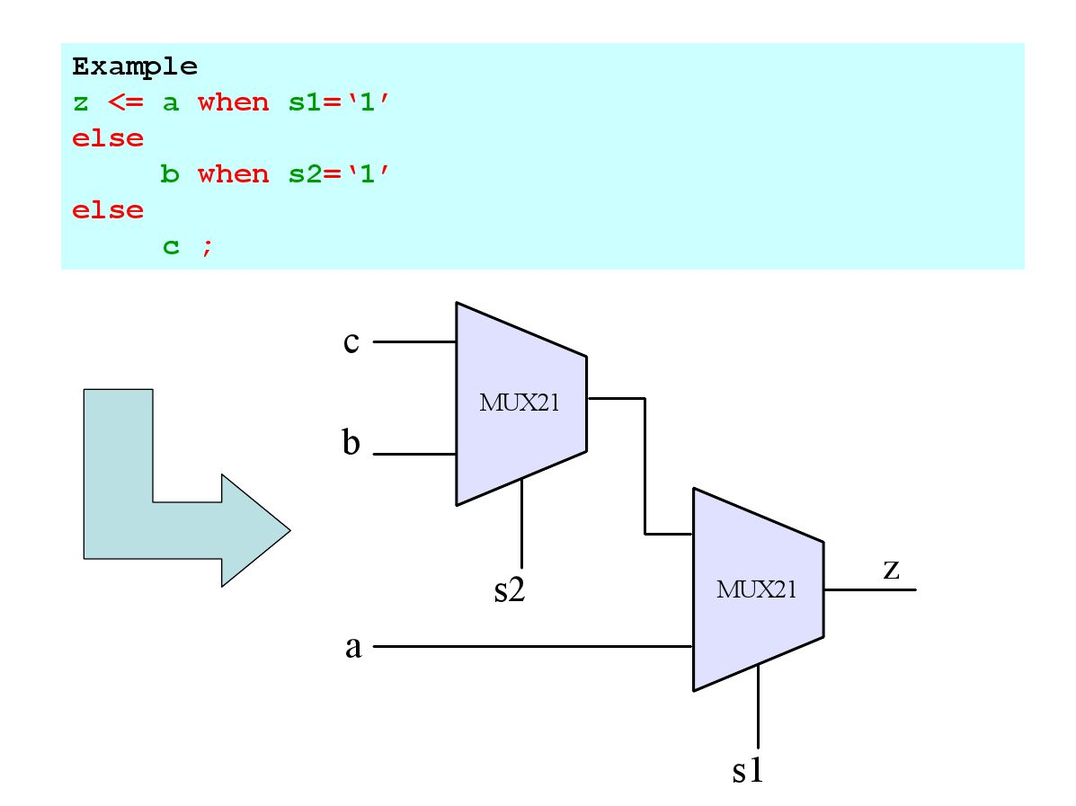

Slide 52
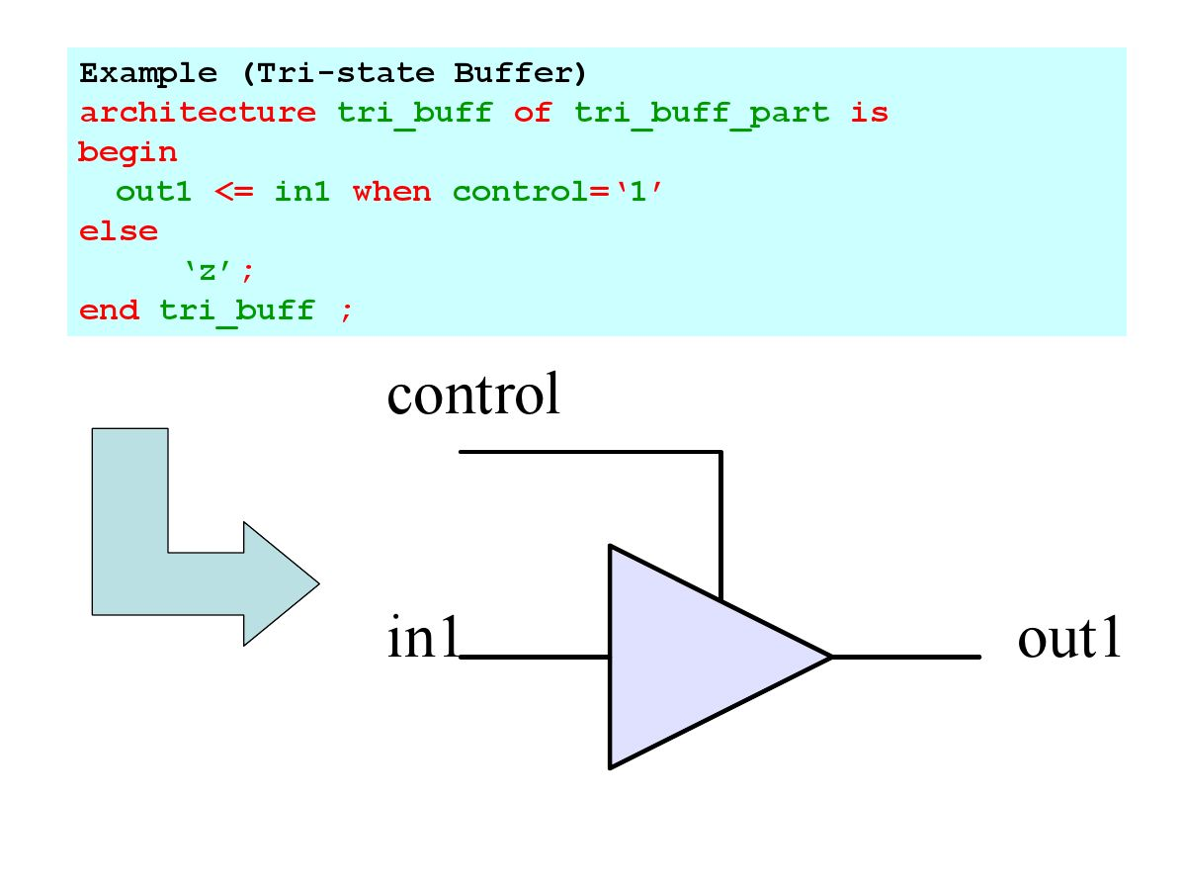

Slide 53
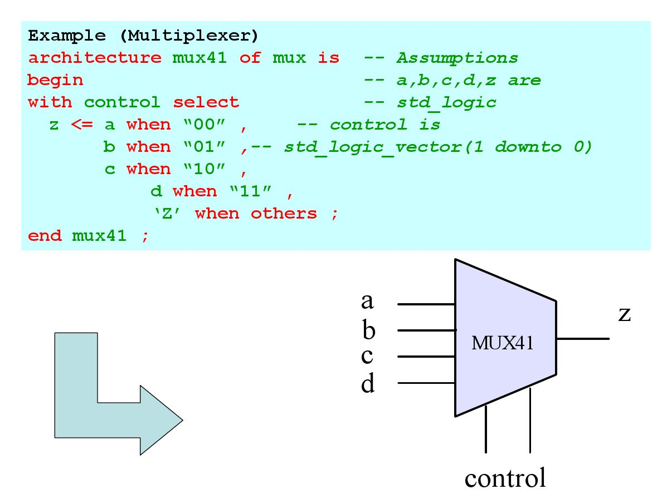

Slide 54


Slide 55


Slide 56


Slide 57


Slide 58


Slide 59


Slide 60


Slide 61


Slide 62


Slide 63


Slide 64


Slide 65


Slide 66


Slide 67


Slide 68


Slide 69


Slide 70


Slide 71


Slide 72


Slide 73


Slide 74


Slide 75


Slide 76


Slide 77


Slide 78


Slide 79


Slide 80


Slide 81
THANK YOU

